Slide 1
This slide is hidden.
Insert the starting slides after this slide

Slide 2
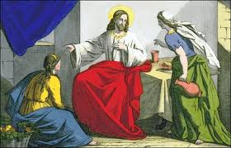
Welcome to St Patrick’s
16th Sunday in Ordinary Time Year C
We are called to welcome others…
Please ensure all mobile phones are switched off.
Please be respectfully quiet as we prepare for our Celebration.
Notes:
Saturday 5.30PM First Sunday of Advent
7am - 7th Sunday in Ord Time Year B

Slide 3
Jesus came to a village, and Martha welcomed him into her house.

Slide 4
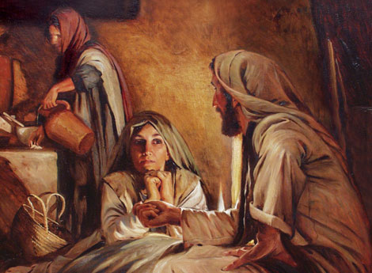
Her sister Mary, sat down at the Lord’s feet and listened to him speaking …

Slide 5
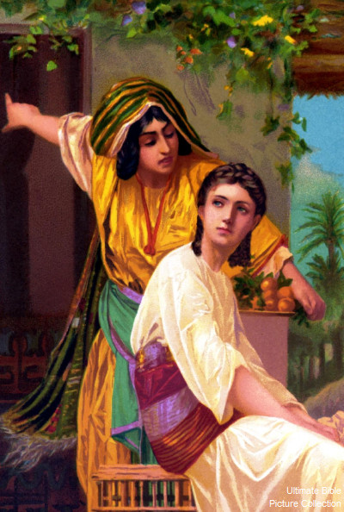
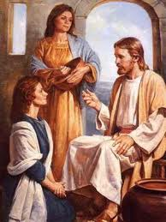
‘Lord, do you not care that my sister is leaving me to do the serving all by myself? Tell her to help me!”’

Slide 6
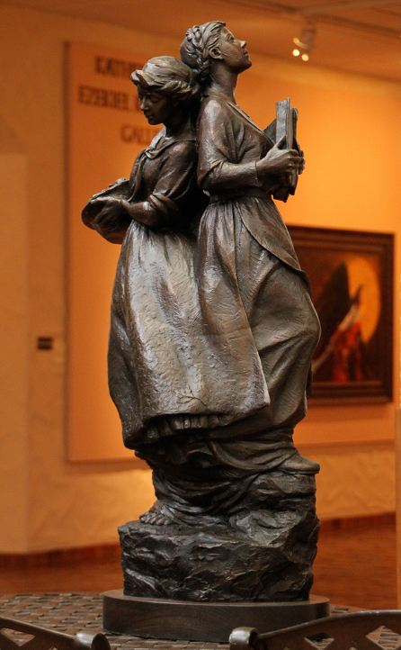
What do you think needs to come first, listening or doing?

Slide 7
Please Stand

Slide 8
This slide is hidden.
Insert the Entrance Hymn after this slide

Slide 9
Praise the name of Jesus
Praise the name of Jesus
Praise him as we pray
Praise the name of Jesus
Sing to him all our days

Slide 10
From the rising of the sun
To the setting of the same
The name of the Lord is to be praised
In all things let's praise his name
And so let's

Slide 11
Praise the name of Jesus
Praise him as we pray
Praise the name of Jesus
Sing to him all our days

Slide 12
Let us come unto the Lord
Let us make a joyful noise
He has healed us through his word
In all things let's praise his name
And so let's

Slide 13
Praise the name of Jesus
Praise him as we pray
Praise the name of Jesus
Sing to him all our days
Sing to him all our days

Slide 15
Confiteor
I confess to almighty God
And to you, my brothers and sisters,
That I have greatly sinned
In my thoughts and in my words

Slide 16
In what I have done
And in what I have failed to do,
Through my fault,
Through my fault,
Through my most grievous fault;

Slide 17
Therefore I ask blessed Mary ever-Virgin,
All the Angels and Saints,
And you, my brothers and sisters,
To pray for me to the Lord our God.

Slide 19
Kyrie eleison
Kyrie eleison (2)
Christe eleison (2)
Kyrie eleison (2)

Slide 21
Gloria
Glory to God in the highest,
and on earth peace to people of good will.
We praise you, we bless you,
we adore you, we glorify you,

Slide 22
We give you thanks for your great glory,
Lord, God heavenly king,
O God, almighty father

Slide 23
Glory to God in the highest,
and on earth peace to people of good will.

Slide 24
Lord Jesus Christ, Only Begotten Son,
Lord God, Lamb of God, Son of the Father,
you take away the sins of the world,
have mercy on us;

Slide 25
you take away the sins of the world, receive our prayer;
you are seated at the right hand of the Father,
have mercy on us.

Slide 26
Glory to God in the highest,
and on earth peace to people of good will.

Slide 27
For you alone are the Holy One,
you alone are the Lord,
you alone are the Most High, Jesus Christ,
with the Holy Spirit,
in the glory of God the Father.

Slide 28
Glory to God in the highest,
and on earth peace to people of good will.
Amen.

Slide 30
Responsorial Psalm
The just will live
in the presence of the Lord.

Slide 32
Alleluia
Alleluia, alleluia,
alleluia, alleluia

Slide 34
Apostles Creed
I believe in God,
the Father almighty,
Creator of heaven and earth,
and in Jesus Christ, his only Son, our Lord,
(At the words that follow, up to and including the Virgin Mary, all bow.)

Slide 35
who was conceived by the Holy Spirit,
born of the Virgin Mary,
suffered under Pontius Pilate,
was crucified, died and was buried;
he descended into hell;

Slide 36
on the third day he rose again from the dead;
he ascended into heaven,
and is seated at the right hand of God the Father almighty;

Slide 37
from there he will come to judge the living and the dead.
I believe in the Holy Spirit,
the holy catholic Church,

Slide 38
the communion of saints,
the forgiveness of sins,
the resurrection of the body,
and life everlasting.
Amen.

Slide 40
First Collection
This collection goes to the Bishop
for the support of the Diocese.
Thank you for your contribution

Slide 42
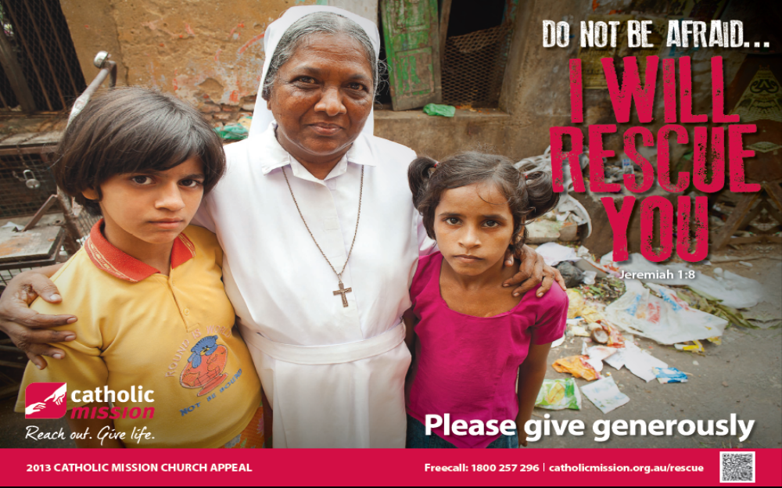
Catholic Mission Appeal:
Envelopes are available for your donation! .

Slide 43
This slide is hidden.
Insert the Offertory Hymn after this slide.

Slide 44
Blessed be God
Blessed are you Lord God or all creation
Thanks to your goodness this bread we offer
Fruit of the earth, work of our hands
It will become the bread of life

Slide 45
Blessed be God, blessed be God
Blessed be God forever amen.
Blessed be God, blessed be God
Blessed be God forever amen

Slide 46
Blessed are you Lord, God of all creation
Thanks to your goodness this wine we offer
Fruit of the vine, work of our hands
It will become the cup of joy

Slide 47
Blessed be God, blessed be God
Blessed be God forever amen.
Blessed be God, blessed be God
Blessed be God forever amen

Slide 49
Priest: Pray my brothers and sisters,
that my sacrifice and yours may be
acceptable to God, the almighty Father.
All: May the Lord accept the sacrifice
at your hands for the praise and glory of his name, for our good and the good of all his holy Church.

Slide 50
Priest: The Lord be with you.
All: And with your spirit.
Priest: Lift up your hearts.
All: We lift them up to the Lord.

Slide 51
Priest: Let us give thanks to the
Lord our God.
All: It is right and just.

Slide 53
Holy
Holy, Holy, Holy Lord God of hosts,
Heaven and earth are full of your glory. Hosanna in the highest
Blessed is he who comes
in the name of Lord,
Hosanna in the highest.

Slide 55
Memorial acclamation
Save us saviour of the world,
For by your cross and resurrection,
You have set us free

Slide 56
Memorial acclamation
When we eat this bread
And drink this cup
We proclaim your death O Lord
Until you come again

Slide 57
Memorial acclamation
We proclaim your death O Lord
And profess your resurrection
Until you come again

Slide 59
Amen
Amen, amen, amen, amen.
Amen, amen, amen, amen.

Slide 61
Priest: The Lord be with you.
All: And with your spirit

Slide 63
Peace
May the peace of the Lord be with you
With your friends and your family too
Let it be, let it grow
And everywhere you go
May the peace of the Lord follow you

Slide 64
Lamb of God
Lamb of God, lamb of God
You take away the sins of the world
Have mercy on us, lamb of God

Slide 65
Lamb of God, lamb of God
You take away the sins of the world
Have mercy on us, lamb of God

Slide 66
Lamb of God, lamb of God
You take away the sins of the world
Grant us, grant us peace

Slide 68
Priest: Behold the Lamb of God, behold him
who takes away the sins of the world.
Blessed are those called to the supper of the Lamb.
All: Lord, I am not worthy
that you should enter under my roof,
but only say the word
and my soul shall be healed.

Slide 69
This slide is hidden.
Insert the Communion Hymns after this slide.

Slide 70
I am the bread of life
Amanda McKenna
I am the Bread of life broken for the world
I am the cup poured out for all
Those who believe in me will never die
I am the life of the world

Slide 71
I am the food that the world cannot give
The food and drink
For those who hunger and thirst
I am the bread sent from heaven
You will have eternal life

Slide 72
I am the Bread of life broken for the world
I am the cup poured out for all
Those who believe in me will never die
I am the life of the world

Slide 73
I am the word from the beginning with God
I am the word alive and with you now
I am the word made flesh among you
You will have eternal life

Slide 74
I am the Bread of life broken for the world
I am the cup poured out for all
Those who believe in me will never die
I am the life of the world

Slide 75
I am the truth the new law given in love
I am the way; my words are spirit and life.
I am mercy and forgiveness
You will have eternal life

Slide 76
I am the Bread of life broken for the world
I am the cup poured out for all
Those who believe in me will never die
I am the life of the world

Slide 77
I am your friend; I'll always walk with you
Don't be afraid, I gave my life for you
I will walk with you forever
You will have eternal life

Slide 78
I am the Bread of life broken for the world
I am the cup poured out for all
Those who believe in me will never die
I am the life of the world

Slide 79
Jesus, Bread of Life
Amanda McKenna
Jesus, bread of life,
Cup of love poured out for us.
Jesus, lamb of God,
Holy one, gift of peace.

Slide 80
No one can live on bread alone,
But ev'ry word from the mouth of God

Slide 81
Jesus, bread of life,
Cup of love poured out for us.
Jesus, lamb of God,
Holy one, gift of peace.

Slide 82
This is my son, my beloved one.
He is my delight, listen to him.

Slide 83
Jesus, bread of life,
Cup of love poured out for us.
Jesus, lamb of God,
Holy one, gift of peace.

Slide 85
Second Collection
What you contribute now
is for the support of our
parish and its mission.
Thank you for your generosity

Slide 86
This slide is hidden.
Insert the Notices for the week after this slide

Slide 87



SOCIAL JUSTICE AFTERNOON
Sr Noelene Simmons ACRATH
HUMAN TRAFFICKING
2.00PM – Sunday 28 July 2013
St Michael’s Parish Centre
ALL WELCOME!

Slide 88


Slide 89

Welcomers wanted for all Masses
to greet parishioners as they arrive.
Are you a friendly welcoming person ?
Then we have a job for you! - Please start today!
HOSPITALITY

Slide 90

Are you new to our Parish?
Speak with one of our priests;
Email the Parish Office
Write name and contact details on forms at church doors.
Notes:
7am - 7th Sunday in Ord Time Year B

Slide 91

Please take home your bulletins or download it from
www.stmichaelsparish.com
  www.facebook.com/
  blacktowncatholics

Slide 92
This slide is hidden.
The next slide can be used for videos.
Insert the video into the slide.

Slide 94
Priest: The Lord be with you.
All: And with your spirit.

Slide 96
This slide is hidden.
Insert the Recessional Hymns after this slide.

Slide 97
Galilee song
Deep within my heart I feel
Voices whispering, to me;
Words that I can’t understand,
Meanings I must clearly hear,

Slide 98
Calling me to follow close,
Lest I leave myself behind.
Calling me to walk into
Evening shadows one more time.

Slide 99
So I leave my boats behind
Leave them on familiar shores
Set my heart upon the deep
Follow You again my Lord.

Slide 100
In my memories I know
How you send familiar rains
Falling gently on my days,
Dancing patterns on my pains

Slide 101
And I need to learn once more,
In the fortress of my mind,
To believe in falling rain,
As I travel deserts dry.

Slide 102
So I leave my boats behind
Leave them on familiar shores
Set my heart upon the deep
Follow You again my Lord.

Slide 103
This slide is hidden.
Insert the final slide here.

Slide 104
What do you think needs to come first, listening or doing?

